Slide 1
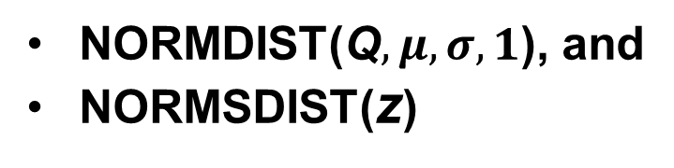
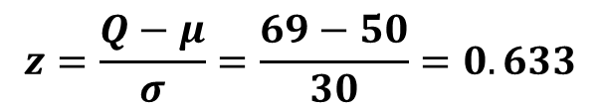
Example 1
You are the manager of the local Best Buy store. Your weekly demand for Apple iPad follows a normal distribution with mean 50 and SD 30. You have 69 iPads in stock at the beginning of the week. No additional receipts are expected during the week. What is the chance of stock-out during the week?
Need: Prob {D > 69} = 1 - Prob {D ≤ 69}
Solution using z-table
Solution using Excel
1. For Q = 69,
$$z=\frac{Q−μ}{σ}=\frac{69−50}{30}=0.633$$
Two Excel functions to find Pr{D≤ 69}
NORMDIST(Q$,μ,σ,1$), and
NORMSDIST(z)
2. Use z-table. For z = 0.633, find
probability. This is Pr {D≤ 69}.
Pr{D≤ 69} = NORMDIST(69,50,30,1)
3. From z-table, Pr{D≤ 69} = 0.7389.
= NORMSDIST((69-50)/30)
= 0.7367
4. Answer = 1 - Pr{D≤ 69} = 0.2611.
Answer = 0.2633

Slide 2
What have we done so far?
Given inventory, found probability
Let us look at the opposite problem ….
Given probability, find inventory required

Slide 3
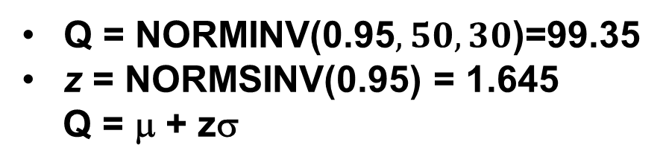
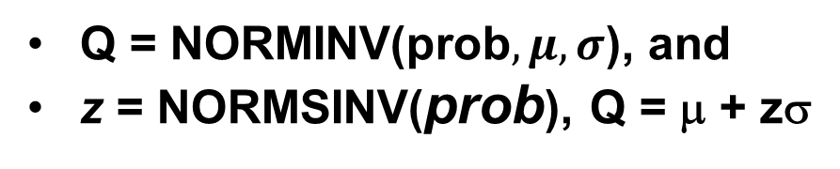
Example 2 (Opposite of Example 1)
You are the manager of the local Best Buy store. Your weekly demand for Apple iPad follows a normal distribution with mean 50 and SD 30. How many iPads should you stock so that chance of stock-out is 5% or lower?
Need Q such that: Prob {D ≤ Q} = 95% or higher
Solution using z-table
Solution using Excel
1. Look inside the z-table. Find 0.95
probability. Pick corresponding z.
z = 1.65
Two Excel functions:
Q = NORMINV(prob$,μ,σ$), and
z = NORMSINV(prob), Q = μ + zσ
2. Convert to Q
Q = μ + zσ
= 50 + 1.65 × 30
= 99.5 or 100.
Solution:
Q = NORMINV(0.95$,50,30$)=99.35
z = NORMSINV(0.95) = 1.645
Q = μ + zσ

Slide 4
Summary: EXCEL
Type 1 Problem: Demand distribution known. 69 iPads in stock, what is the probability for having/not having a stock-out?
Given: inventory or quantity Q, μ, σ
Find: SL, or in-stock prob., or stock-out probability
SL = NORMDIST(Q,μ,σ, 1)
= NORMSDIST([Q−μ]/σ)
Excel 2013 Format
SL = NORM.DIST(Q,μ,σ, 1)
= NORM.S.DIST([Q−μ]/σ)
Type 2 Problem: Demand distribution known. Need 99% chance of not having a stock-out (or 1% chance of stock-out). How many to stock?
Given: probability, and μ, σ
Find: Inventory (Q). Q = μ + zσ
Q = NORMINV(β,μ,σ)
Z = NORMSINV(β), Q = μ +zσ
Excel 2013 Format
Q = NORM.INV(β,μ,σ)
Z = NORM.S.INV(β)

Slide 5
Normal distribution,
finding probabilities and ..
..the related supply
chain concepts

Slide 6
All About the Service
EXAMPLE 1. You are the manager of the local Best Buy store. Your weekly demand for Apple iPad follows a normal distribution with mean 50 and SD 30. You have 69 iPads in stock at the beginning of the week. No additional receipts are expected during the week.
What is the chance of stock-out during the week?
Answer = 26.33%
Chance of stock-out is 26.33%
Chance of not having stock-out is 73.67% (also called Service Level, Cycle Service Level, or in-stock probability)
The service level (SL) performance measure
Chance of not having a stock-out in between replenishments
Stock-out probability = 1 – in-stock probability
Will use SL, CSL, in-stock probability interchangeably

Slide 7
All About the Service
The service level (SL) performance measure
Chance of not having a stock-out in between replenishments
Lead-time
Time
Place
order
Receive
replenishment
Place
order
This is the time interval
when stock-out might happen

Slide 8
All About the Service
The service level (SL) performance measure
Chance of not having a stock-out in between replenishments
What does it measure? Not measure?
Measure: whether there will be a shortage (yes/no)
Not Measure: how many units short (no., no. as % of mean)
The concept of fill rate

Slide 9
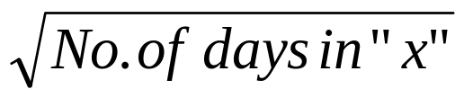
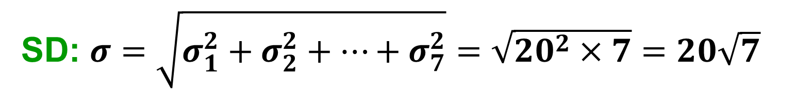
Example 3: Adding Normal Distributions
The daily demand for iPads at the local Best Buy store follows normal distribution with average 50 and SD 20. The lead-time (L) for replenishment is one week. What is the demand during lead time?
Weekly demand is normal with (assume 7 days in a week):
Mean: $μ=μ_{1}+μ_{2}$+…+$μ_{7}=50+50+…+50=350$
SD: $σ=\sqrt{σ_{1}^{2}+σ_{2}^{2}+…+σ_{7}^{2}}=\sqrt{{20}^{2}×7}=20\sqrt{7}$
Mean of demand during “x” days = Daily mean * x
SD of demand during “x” days = Daily SD *

Slide 10
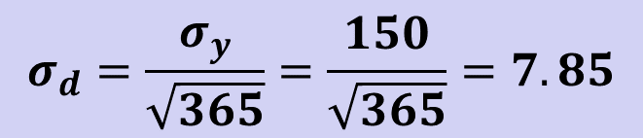
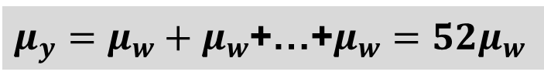
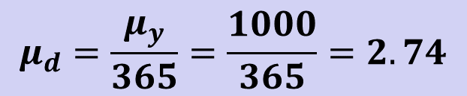
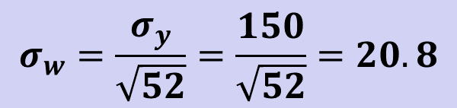
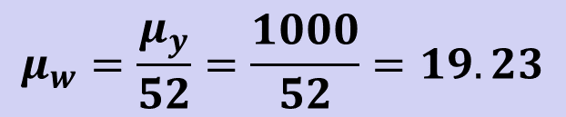
Practice Problem
The annual demand for iPads at the local Best Buy store follows normal distribution with average 1000 and SD 150. What is the weekly demand? What is the daily demand?
Weekly Demand
Daily Demand
$μ_{y}=μ_{w}+μ_{w}$+…+$μ_{w}=52μ_{w}$
$$μ_{d}=\frac{μ_{y}}{365}=\frac{1000}{365}=2.74$$
$$μ_{w}=\frac{μ_{y}}{52}=\frac{1000}{52}=19.23$$
$$σ_{y}=\sqrt{σ_{w}^{2}+σ_{w}^{2}+…+σ_{w}^{2}}=\sqrt{σ_{w}^{2}×52}=σ_{w}\sqrt{52}$$
$$σ_{d}=\frac{σ_{y}}{\sqrt{365}}=\frac{150}{\sqrt{365}}=7.85$$
$$σ_{w}=\frac{σ_{y}}{\sqrt{52}}=\frac{150}{\sqrt{52}}=20.8$$
Subscripts: y = year, w = week, d = day

Slide 11
Key Takeaways: Stat Review
Normal distribution is simple yet powerful
  Allows us to quantify variability
  End consumer demand is normal
Computing probabilities using z-table
Computing probabilities using Excel functions
  NORMDIST, NORMSDIST, NORMINV, NORMSINV
Concepts of service level and lead-time
Adding normal distributions

Slide 12

Lecture Outline
Introduction: Couse Logistics & Overview
Statistics Overview
  Normal Distribution, Service Level
  In-class Exercise
Inventory Management – 1
  The Newsvendor Model
  Applications
  Other Models (time permitting)
Summary

Slide 13
In-class Exercise
703 Electronics

Slide 14

Questions?
Comments?

Slide 15
Lecture Outline
Introduction: Couse Logistics & Overview
Statistics Overview
  Normal Distribution, Service Level
  In-class Exercise
Inventory Management – 1
  The Newsvendor Model
  Applications
  Other Models (time permitting)
Summary

Slide 16
Purposes of Inventory
1. To maintain independence of operations.
2. To meet variation in product demand.
3. To allow flexibility in production scheduling.
4. To provide a safeguard for variation in raw material delivery time.
5. To take advantage of economic purchase-order size.
Notes:
4

Slide 17
Classifying Inventory Models
Inventory Models
Repeat Purchase
One-shot
Newsvendor
Fixed Order Qty
(continuous review)
Fixed Time Period
(periodic review)
Today!
Next 2 Weeks
(Q, R)
policy
Base stock
policy
(s, S)
policy
EOQ
Fixed Dmd
Setup cost
Random Dmd
Setup cost
Random Dmd
No setup cost
Random Dmd
Setup cost

Slide 18
Lecture Outline
Introduction: Couse Logistics & Overview
Statistics Overview
  Normal Distribution, Service Level
  In-class Exercise
Inventory Management – 1
  The Newsvendor Model
  Applications
  Other Models (time permitting)
Summary

Slide 19
The Newsvendor Model
Style goods, fashion goods, perishable goods (single shot)
Buyers have to commit themselves to a large extent before start of selling season
How much should you order?
When total demand in the selling season exceeds stock level, there are underage costs C_{u} (eg. lost profits)
When total demand in the selling season is less than the stock level, there are overage costs C_{o} (eg. salvage costs)

Slide 20
The Newsvendor Model
You know actual sales
and realized profit
(numbers for balance sheet)
Get supply
Time
Decide how much
And place order
(demand random)
Know demand,
sale takes place
This is what we are after.

Slide 21
Motivation: WSJ, Feb 18, 1999
Mattel was hurt last year by inventory cutbacks at Toys “R” Us, and officials are also eager to avoid a repeat of the 1998 Thanksgiving weekend. Mattel had expected to ship a lot of merchandise after the weekend, but retailers, wary of excess inventory, stopped ordering from Mattel. That led the company to report a $500 million sales shortfall in the last weeks of the year ... For the crucial holiday selling season this year, Mattel said it will require retailers to place their full orders before Thanksgiving. And, for the first time, the company will no longer take reorders in December, Ms. Barad said. This will enable Mattel to tailor production more closely to demand and avoid building inventory for orders that don't come.

Slide 22
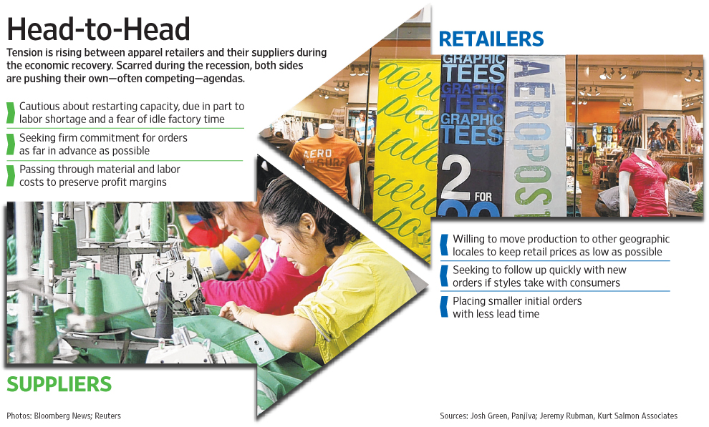
Motivation: WSJ, July 16, 2010

Slide 23
The Newsvendor Model
D = Random demand ~ N(μ, σ)
F(Q) = Area under the normal dist. curve of demand up to Q
Cu = Shortage (underage) cost per unit
Co = Excess (overage) cost per unit
Q = Quantity to be ordered
Found from
definition
Example: p = selling price; c = cost; s = salvage value, s < c
Cu = p – c, and Co = c- s
Decision Variable
What is the Optimal Order Quantity?
(Maximize expected profit)

Slide 24
The Idea
Balance the risks
Look at the last item
  What did it promise?
  What risk (loss) did it pose?
If Promise is greater than the risk?
If the Risk is greater than the promise?

Slide 25
Balance Risk and Return
Profit from the last item
  $ Cu (= p-c) if the demand is greater than Q, $0 otherwise
Expected Profit
  $ Cu*Probability demand is greater than our choice Q
Risk (loss) posed by last item
  $ Co (= c-s) if the demand is smaller than Q, $0 otherwise
Expected Risk
  $ Co*Probability demand is smaller than our choice Q
Expected Profit = Expected Risk

Slide 26
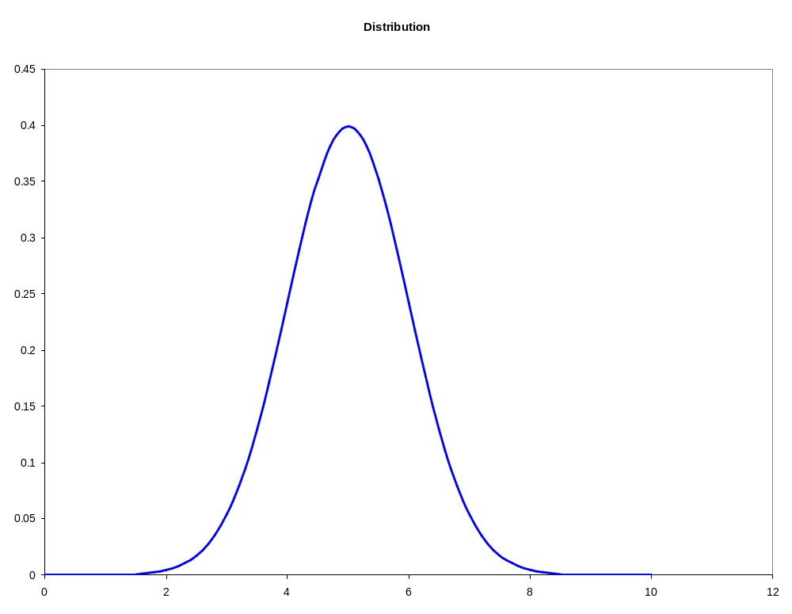
Risk & Reward
Prob. demand is smaller than Q
F(Q)
Our choice = Q
Prob. demand is larger than Q
1 – F(Q)
Q

Slide 27
Balance Risk and Return
Profit from the last item
  $ Cu (= p-c) if the demand is greater than Q, $0 otherwise
Expected Profit
  $ Cu*Probability demand is greater than our choice Q
Risk (loss) posed by last item
  $ Co (= c-s) if the demand is smaller than Q, $0 otherwise
Expected Risk
  $ Co*Probability demand is smaller than our choice Q
1 – F(Q)
F(Q)
Cu* [1-F(Q)] = Co* F(Q)

Slide 28
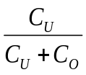
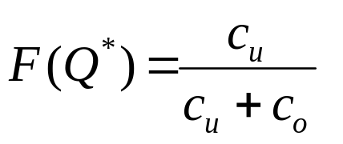


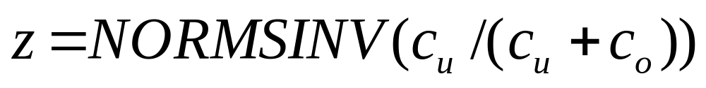
The Newsvendor Model
D = Random demand ~ N(μ, σ)
F = Area under the normal dist. curve of demand up to Q
Cu = Shortage (underage) cost per unit
Co = Excess (overage) cost per unit
Q = Quantity to be ordered
The ratio
is called critical ratio
Optimal Order Quantity

Slide 29
Example
Sport Obermeyer Inc. (SO) manufacturers high-end ski parkas at their manufacturing facility in Hong Kong. The parkas are fashion products and SO induces new designs every year. The manufacturing cost of a parka is $120, and it sells for $250 at the ski resorts during the winter season (Jan-Apr). Any left over inventory after March/April must be liquidated through
markdowns as this years designs are worthless next year. SO typically markdowns its parkas to $70 (I.e. below the manufacturing cost) around April every year. The manufacturing lead time for the parkas are 12 moths.
As a result, SO must make production decision before knowing the actual demand. SO estimated that the demand is approximately Normal with mean 400 and SD 170.
How many parkas should SO produce for next year?

Slide 30
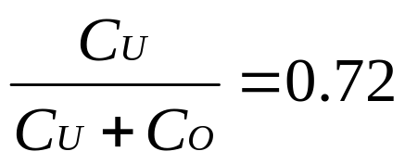
Solution
D ~ N(400, 170), p = $250, c = $120, s = $70
1. C_{U} = $250 – $120 = $130; C_{o} = $120 - $70 = $50
2. Therefore,
3. From EXCEL, z = NORMSINV(0.72) = 0.582
4. Therefore, Q* = μ + zσ = 498.94 or 499

Slide 31
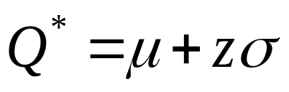
The Newsvendor Model
Optimal Order Quantity:
F(Q*)
μ
Q
What is it?
Q*
Area under the curve represents probability (or in-stock probability or service level)
Therefore, the optimal order quantity results in a service level of Cu/(Cu+Co)

Slide 32
The Newsvendor Model
You know actual sales
and realized profit
(numbers for balance sheet)
Get supply
Time
See demand,
sale takes place
Decide how much
And place order
(demand random)
Found Q*.
So what?
The max exp. profit you can get
What is the resulting SL? We need better SL…

Slide 33
What have we done so far?
Found order quantity that maximizes exp. profit but ignores service level
So let us make it more practical:
Maximize exp. profit AND..
meet service level requirements (say, x%)
Solution:
Q* = μ + z*σ ,
where z = NORMSINV(x%)

Slide 34
Newsvendor for a given SL
Need optimal order quantity for 99% SL
(maximize profit and ensure SL)
Problem data: D ~ N(400, 170), p = $250, c = $120, s = $70
(same data as the SO example problem)
1. C_{U} = $250 – $120 = $130; C_{o} = $120 - $70 = $50
2. No need to find critical ratio when SL is given
3. From EXCEL, z = NORMSINV(0.99) = 2.326
Therefore, Q* = μ + zσ = 400 + 2.326*170 = 795.48 or 796

Slide 35
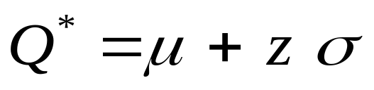
Summary: The Newsvendor Model
Optimal Order Quantity
(μ, σ given or found from data)
Max. exp. profit,
disregard SL
Newsvendor Setting
Demand is random
Order before knowing demand
All economic parameters known
Max. profit &
ensure x% SL
C_{u}
z = NORMSINV( )
z = NORMSINV(x%)
or use z table
Cu + Co
or, use z-table

Slide 36
Lecture Outline
Introduction: Couse Logistics & Overview
Statistics Overview
  Normal Distribution, Service Level
  In-class Exercise
Inventory Management – 1
  The Newsvendor Model
  Applications
  Other Models (time permitting)
Summary

Slide 37
Applying the newsvendor
model in practice (1 of 2) ..
Claim:
It is a newsvendor world!

Slide 38
Many different types of
problems can be translated
into newsvendor by
cleverly computing
Cu & Co

Slide 39
Computing Cu and Co
Who/what is the newsvendor?
What is the loss for unit shortage ?
What is the loss for unit excess?
Examples
Newspaper: p =$1, c =$0.50, s =$0.05
Apparel: p =$1, c =$0.50, s =$0, tax benefit t =$0.05
p =$1, c =$0.50, s =$0.10, t =$0.05, donate 25%, salvage 75%

Slide 40
EX 1: Revenue Mgmt.
The same unit of capacity (e.g., airline seat) can be used to deliver services to different customer segments (e.g., business and leisure customers) at different prices.
0
K (capacity)
Sell no more than the low
Fare (p_{L}) booking limit, K - Q
Q seats protected for
high fare customers (p_{H})
Newsvendor!
C_{u} = p_{H} – p_{L}
, C_{O} = p_{L}
How many (Q) to sell at high price?

Slide 41
EX 2: SCM Capacity Issues
1. Selling Capacity: Bulk vs. Spot
Example: warehouse space, contract manufacturing capacity
Discount for reserving early and/or for longer term (bulk)
Spot/short-term capacity is expensive
Problem: how much capacity to sell in bulk
Newsvendor
again!
2. Buying Capacity: Bulk vs. Spot
Example: buying contract manufacturing capacity
Discount for reserving early (bulk)
Spot capacity is expensive
Problem: how much capacity to buy in bulk
Sellers also offer options in electronics industries

Slide 42
In-class exercise
(Motivated by WSJ article)

Slide 43
Solution: Practice Problem
Part (a)
Cu = 22-10 = 12, Co = 10-0 = 10, Critical ratio = 0.5455
z = NORMSINV(0.5455) = 0.1143.
Q* = μ + zσ = 2100+0.1143×1200 = 2237.16 or 2238.
Part (b)
Cu = 15-10 = 5, Co = 10-0 = 10, Critical ratio = 0.3333
z = NORMSINV(0.3333) = -0.431.
Q* = μ + zσ = 2100-0.431×1200 = 1582.8 or 1583.

Slide 44
Remember:
We compute Cu and Co
from the definition of the
problem

Slide 45
Applying the newsvendor
model in practice (2 of 2) ..
Claim:
It is a newsvendor world!

Slide 46
Many seemingly hard problems
can be translated into newsvendor
and solved by
cleverly computing
μ & σ from “some” data
What data? It is a new product!
That is more of an “art” than “science”
Example 1: O'Neill example from SCM 701
Example 2: Sport Obermeyer Case

Slide 47
Lecture Outline
Introduction: Couse Logistics & Overview
Statistics Overview
  Normal Distribution, Service Level
  In-class Exercise
Inventory Management – 1
  The Newsvendor Model
  Applications
  Other Models (time permitting)
Summary

Slide 48
Lecture Outline
Introduction: Couse Logistics & Overview
Statistics Overview
  Normal Distribution, Service Level
  In-class Exercise
Inventory Management – 1
  The Newsvendor Model
  Applications
  Other Models (time permitting)
Summary

Slide 49
Summary & Key Takeaways
Normal distribution & probability computations
  Excel functions
The newsvendor model
  When applicable
  Diverse applications

Slide 50
Next Class:
Inventory management - 2
Read
  Sport Obermeyer case
  Your SCM 701 notes on EOQ model
  Base stock policy, eBook p.20-39
Summary slides to be posted before the class

